Slide 1
Cybersecurity
Grigore Lucian-Florin 324CD

Slide 2
Main points
Cyber war has evolved in the same way technology has.
What should one do to protect himself?
What will happen in the future?

Slide 3
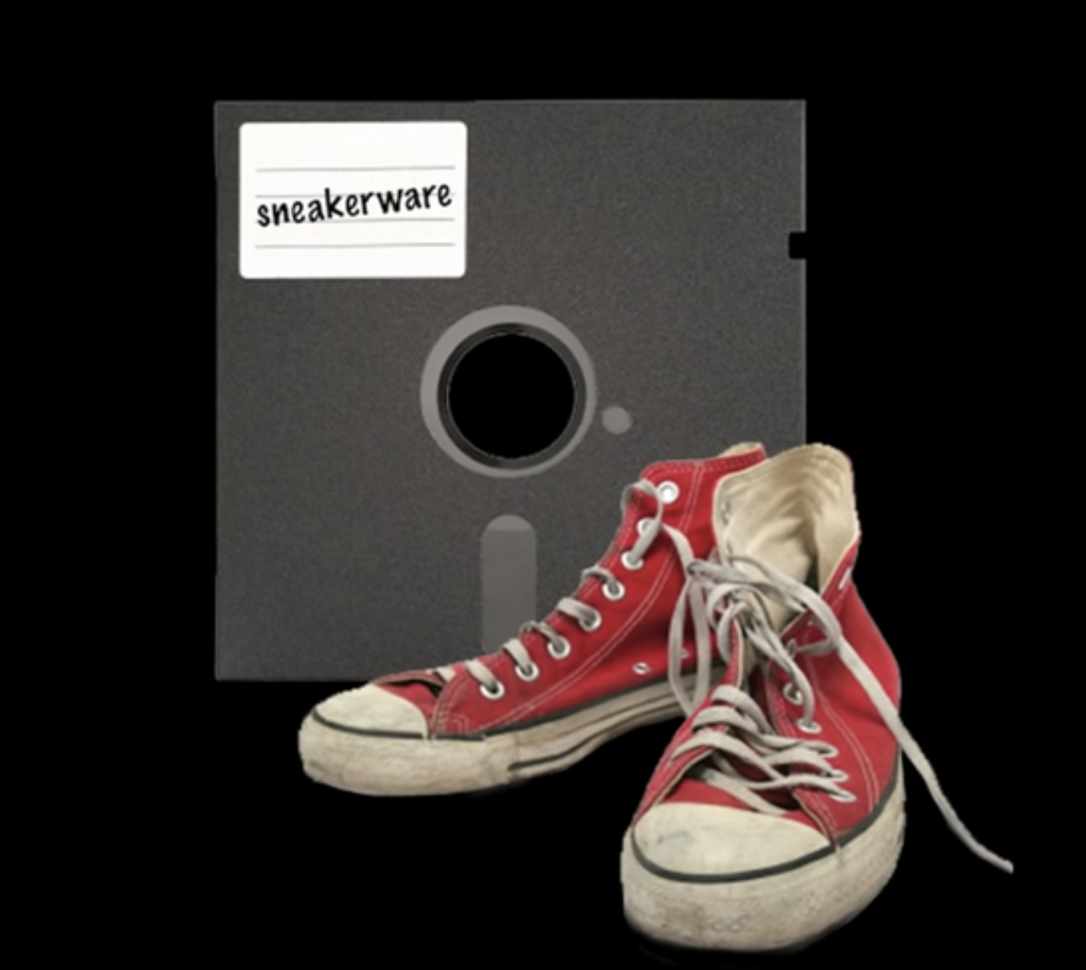
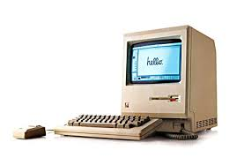
Where it all started

Slide 4
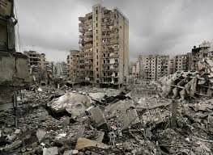
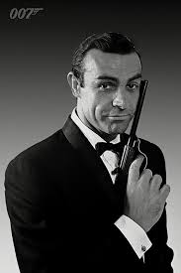

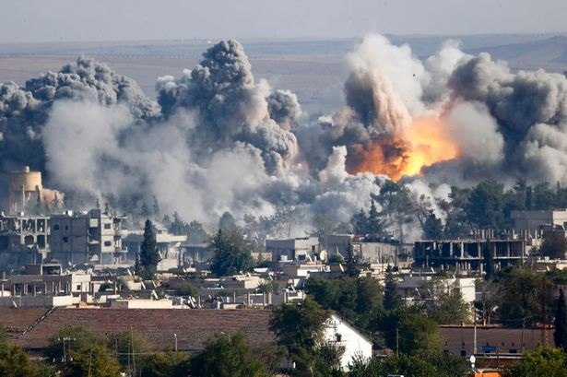
A silent war

Slide 5
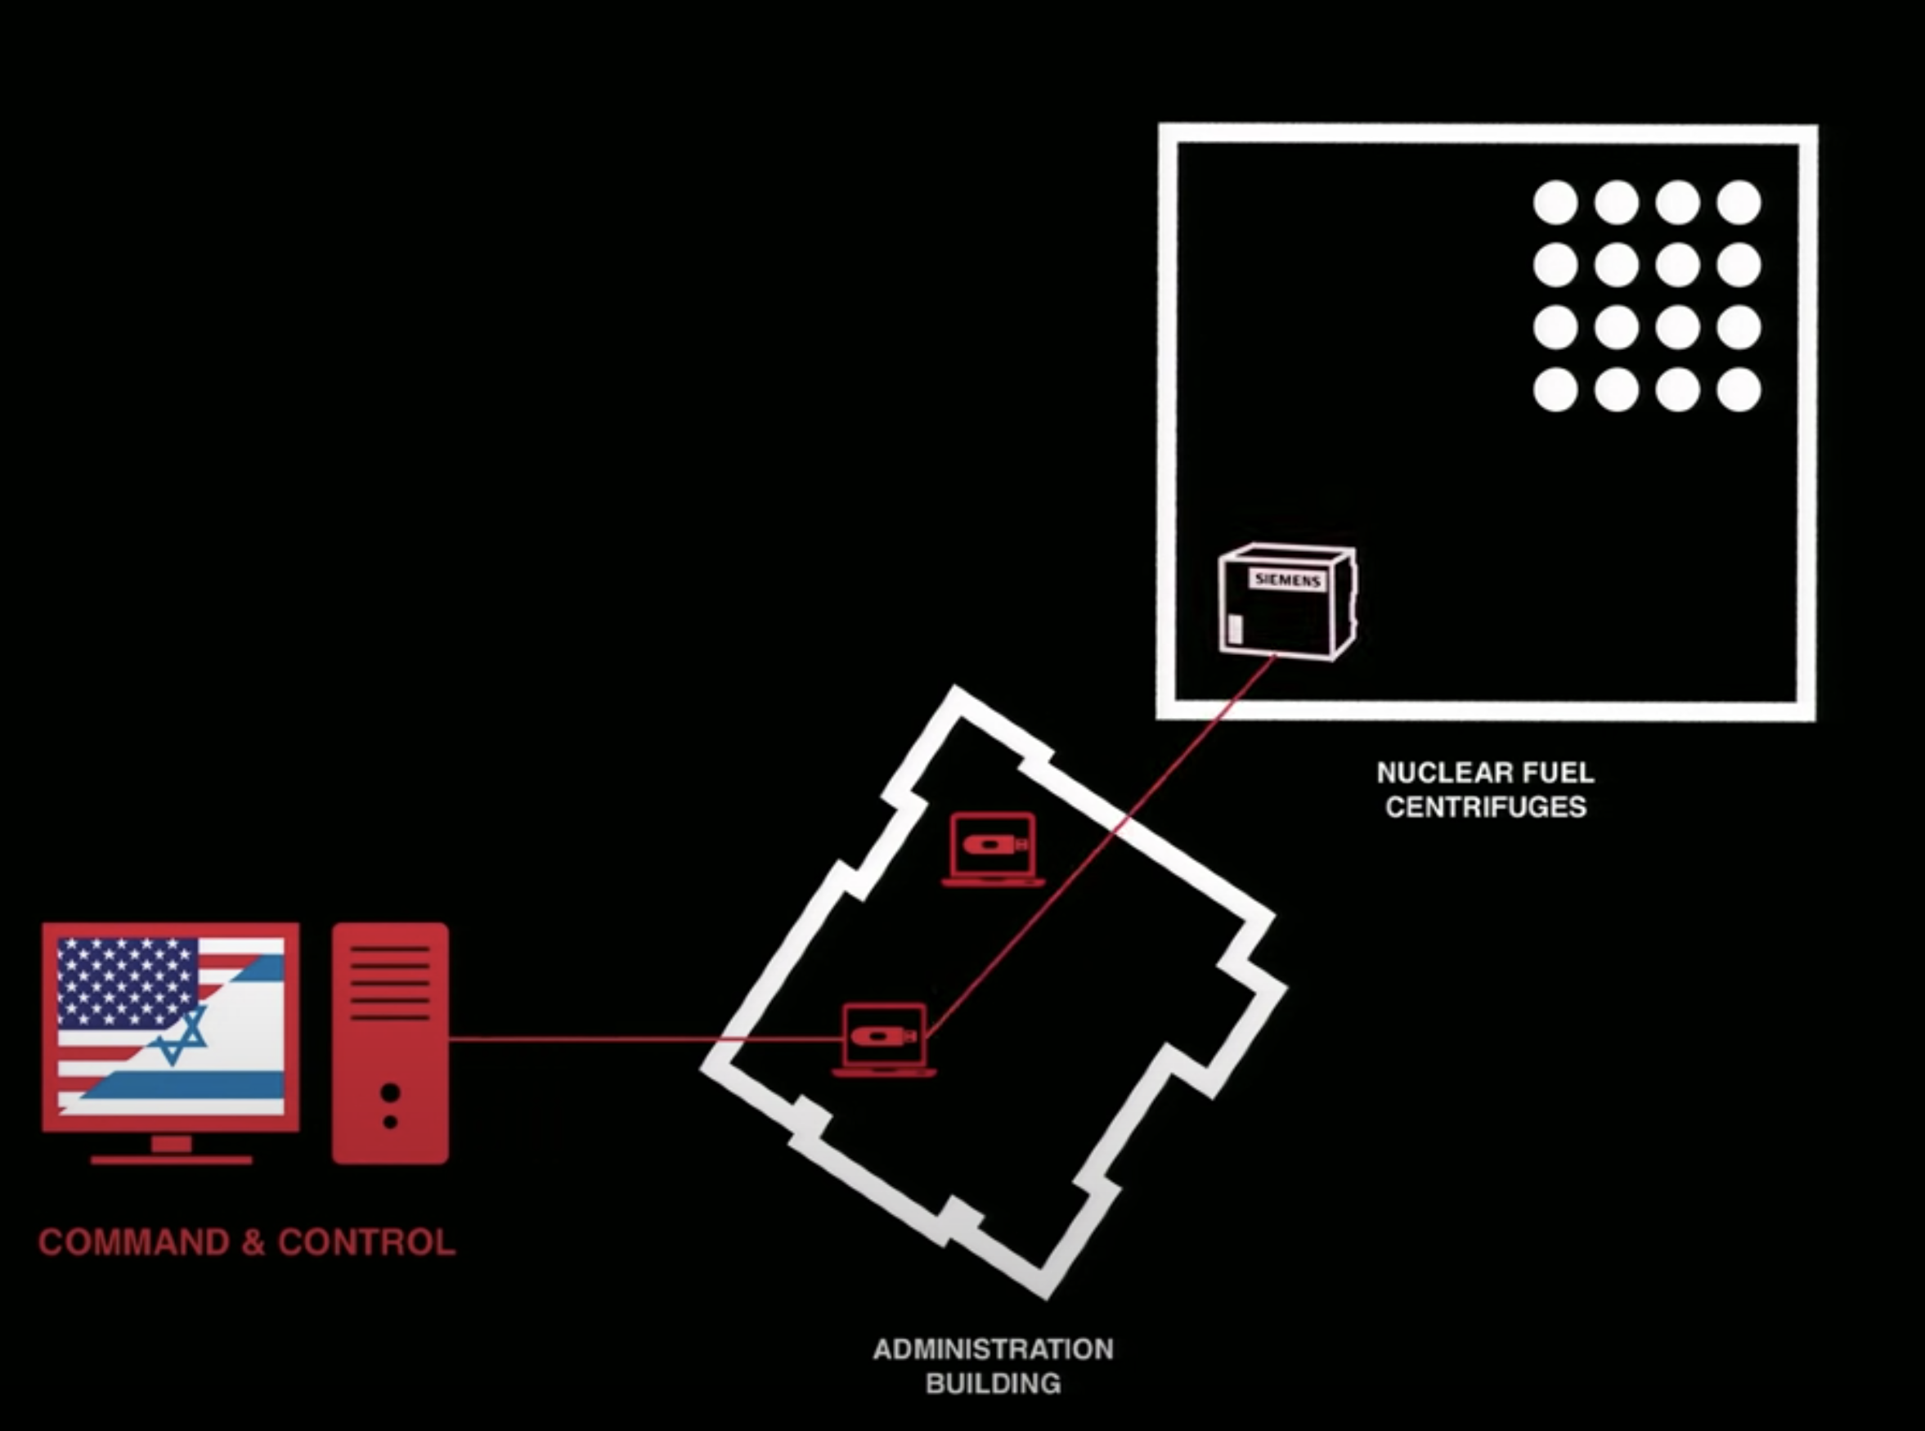
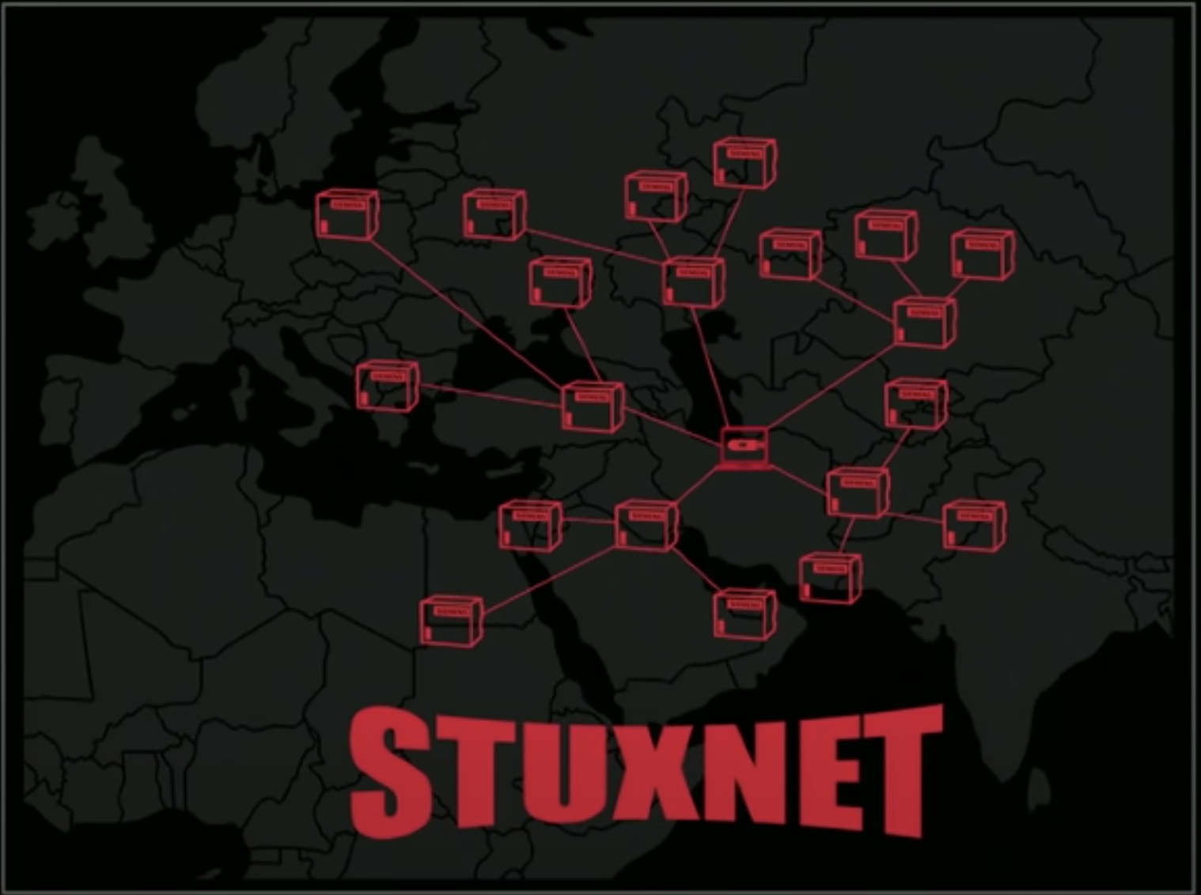

Slide 6

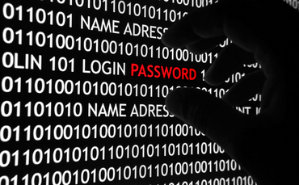
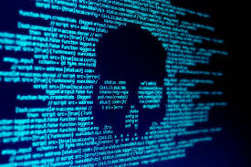
The threat is more real than ever

Slide 7
Can I become the target?
Cambridge Analytica
I LOVE YOU MELISSA
220 million 1.3 billion

Slide 8
The three laws of cybersecurity
If there is a vulnerability, it will be exploited. No exceptions.
Everything is vulnerable in some way.
Humans trust even when they should not.

Slide 9

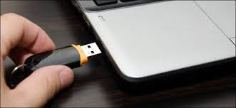

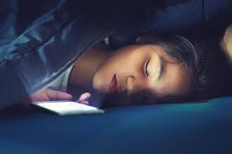
We become more vulnerable

Slide 10
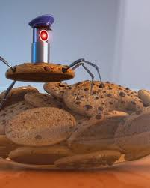
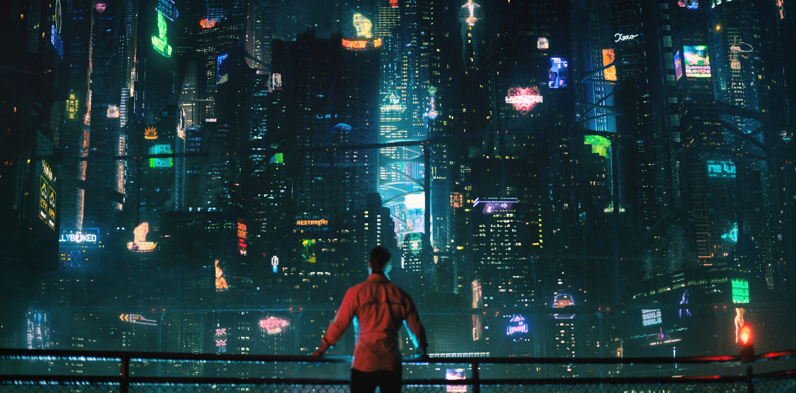
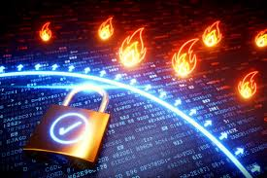
How can we shift the future in our favour

Slide 11


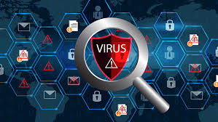
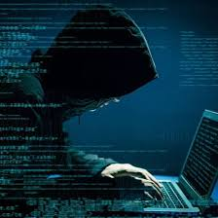
Keep in mind

Slide 12
Thank you for your attention
www.securelist.com
www.cisco.com
www.mcafee.com

